Slide 1
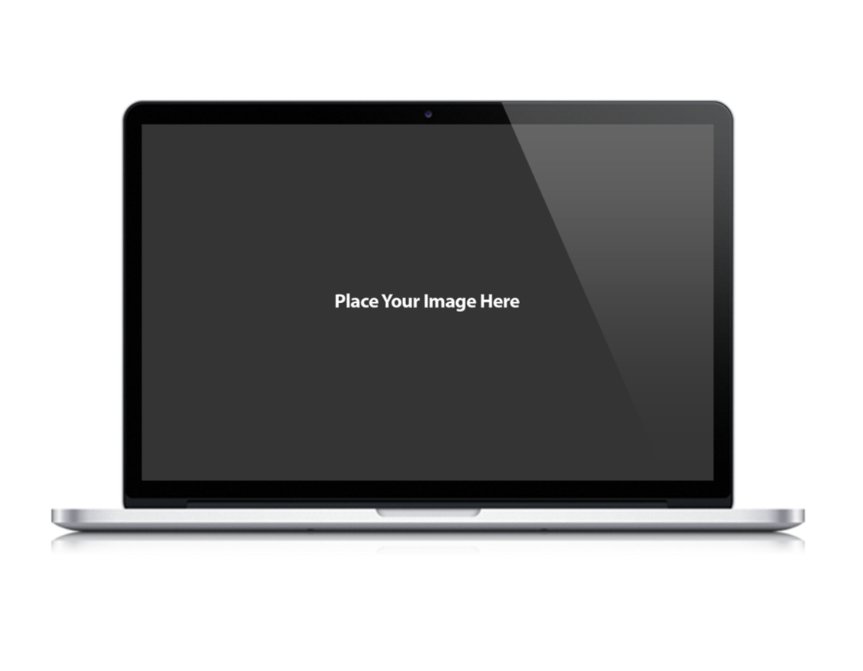
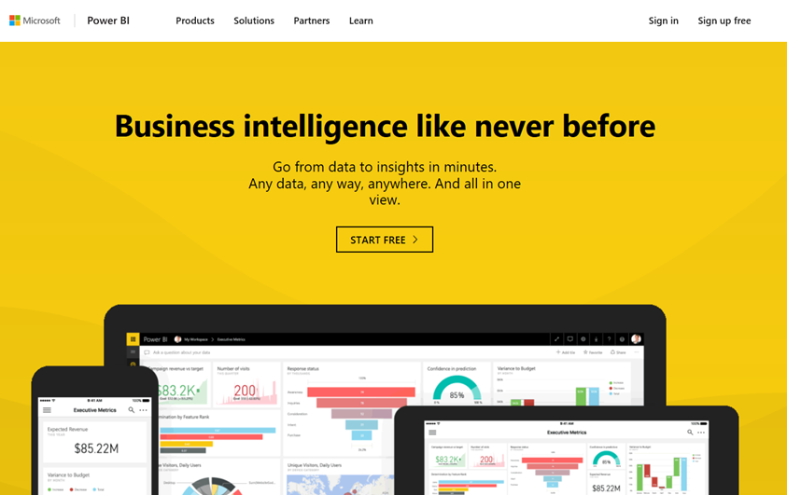
CAT
Microsoft Power BI
App-Owns-Data Starter Kit
Ted Pattison Power BI Customer Advisory Team (PBICAT)

Slide 2
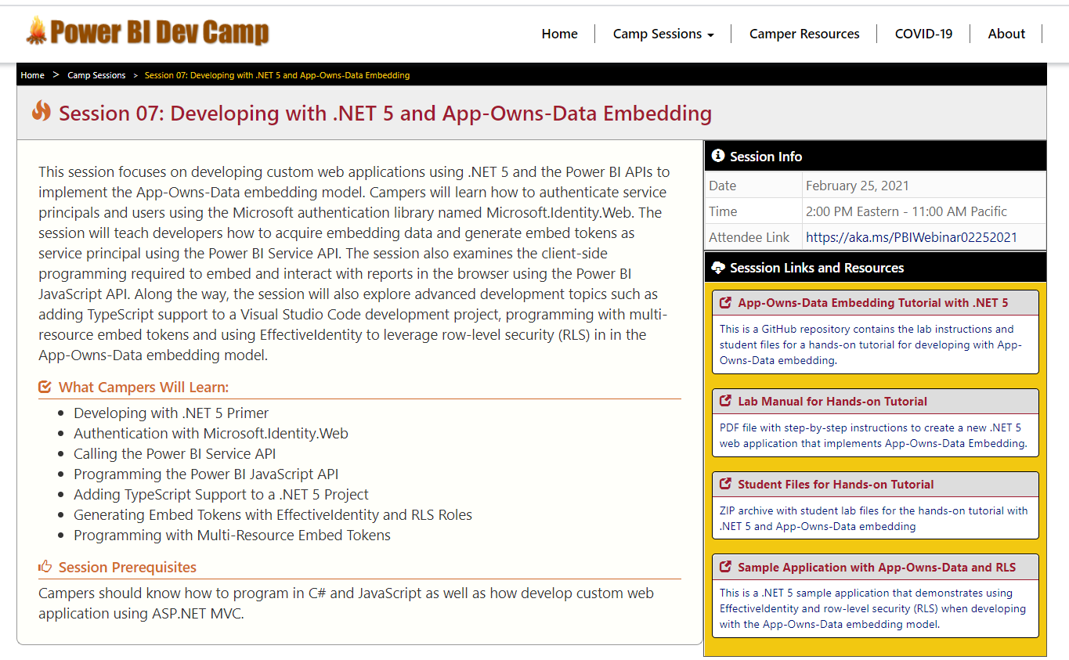
Welcome to Power BI Dev Camp
Power BI Dev Camp Portal - https://powerbidevcamp.net

Slide 3
Agenda
Solution Architecture
Set up your development environment
Open the App-Owns-Data Starter Kit in Visual Studio
Test the AppOwnsDataAdmin application
Test the AppOwnsDataClient application
Use activity logs to monitor user activity and report performance

Slide 4

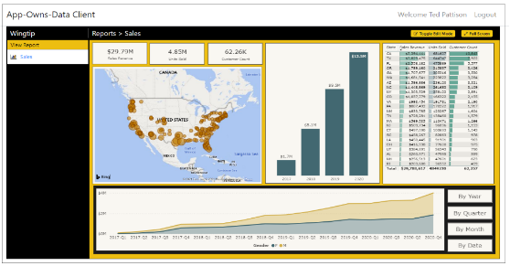
Customer Tenants in App-Owns-Data Embedding
Tenant represents a customer with one or more users
You must create a separate tenant footprint in Power BI for each customer
Power BI environment
Customer 01
17 users
Customer 01 Tenant
Sales
Power BI Workspace
Power BI Dataset
Datasource credentials
Power BI Report

Slide 5
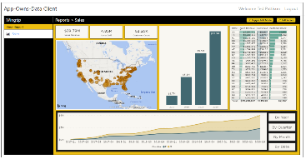
Designing a Multi-tenant Environment
Power BI Multi-tenant environment
Customer 01
17 users
Customer 01 Tenant
Sales
Power BI Workspace
Power BI Dataset
Datasource credentials
Power BI Report
Customer 02
243 users
Customer 02 Tenant
Sales
Power BI Workspace
Power BI Dataset
Datasource credentials
Power BI Report
Customer N
74 users
Customer N Tenant
Sales
Power BI Workspace
Power BI Dataset
Datasource credentials
Power BI Report

Slide 6
App-Owns-Data Embedding & Authorization
Power BI doesn’t know anything about your users
Power BI cannot provide assistance when it comes to authorization
Not an issue in scenario where all users see all content with the same access
Your application must add explicit support for any authorization scheme
Key observations about App-Owns-Data embedding
you have flexibility to design the authorization scheme any way you'd like
you have responsibility to build authorization scheme from the ground up
you should use custom database to track the authorization data you need

Slide 7
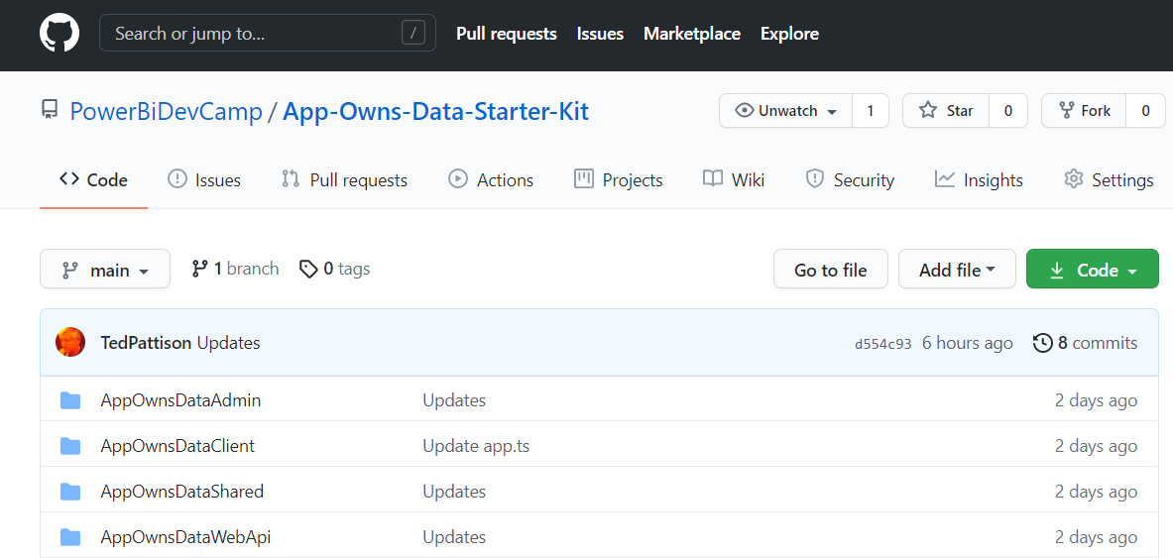
App-Owns-Data Starter Kit
Available in a public GitHub repository
https://github.com/PowerBiDevCamp/App-Owns-Data-Starter-Kit

Slide 8
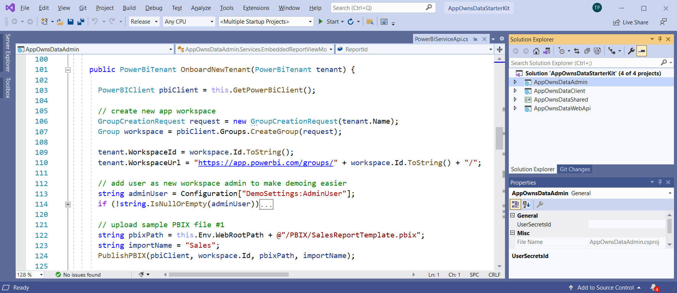
Opening the solution in Visual Studio 2019

Slide 9
App-Owns-Data Starter Kit - Value Proposition
Provides guidance and starter code for the following tasks
Onboarding new customer tenants
Managing user permissions
Implementing the customer-facing client as a Single Page Application (SPA)
Creating a custom telemetry layer to log user activity
Monitoring user actions such as viewing, editing, and creating reports
Monitoring the performance of report loading and report rendering

Slide 10
Solution Architecture
AppOwnsDataAdmin: administrative app to create tenants and manage user permissions.
AppOwnsDataClient: customer-facing SPA used to view and author reports.
AppOwnsDataWebApi: custom Web API used by the AppOwnsDataClient application.
AppOwnsDataAdmin
AppOwnsDataDB
Power BI REST API
AppOwnsDataClient
AppOwnsDataWebAPI

Slide 11
AppOwnsDataAdmin
Provision tenant using Power BI REST API
Adds a record to AppOwnsDataDB for each customer tenant
AppOwnsDataAdmin
Power BI REST API
Azure AD Service App
AppOwnsDataDB

Slide 12
Customer Tenant Provisioning
Provisioning a new customer tenant
create a Power BI workspace
assign workspace to a dedicated capacity
import PBIX files
patch datasource credentials
start dataset refresh operations
create and bind gateway datasources

Slide 13
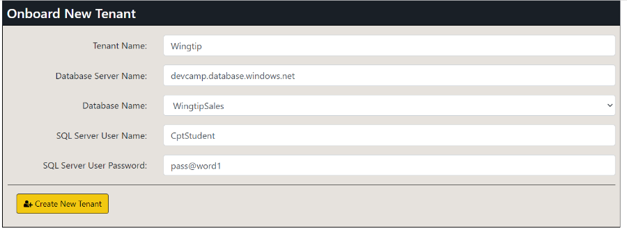
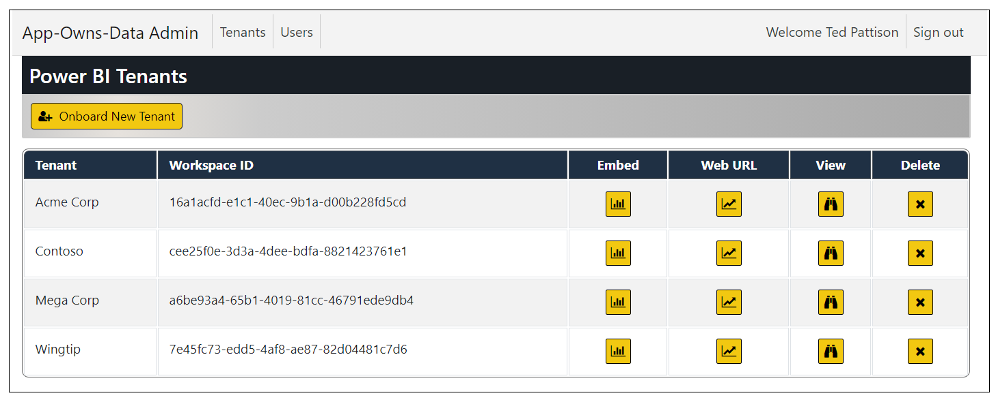
Creating Customer Tenants

Slide 14
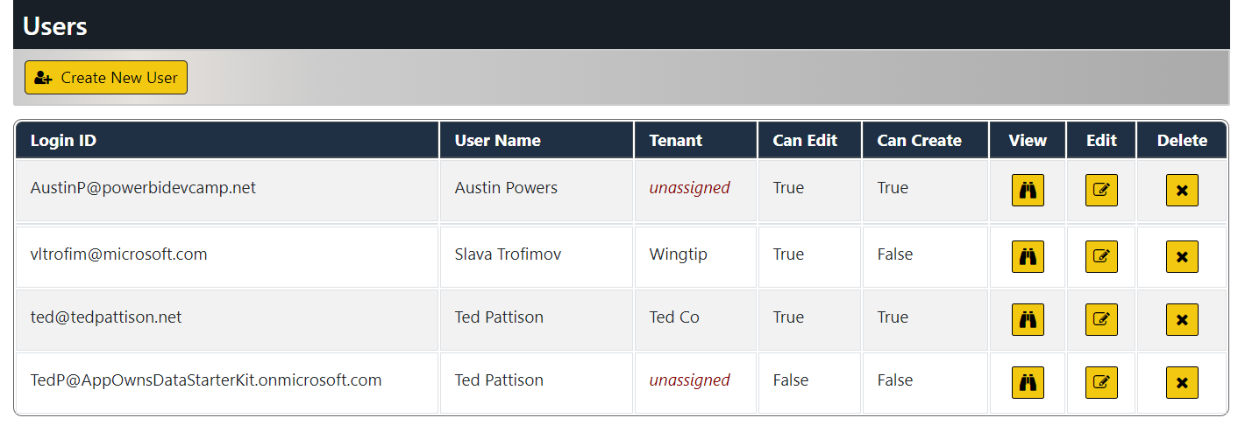
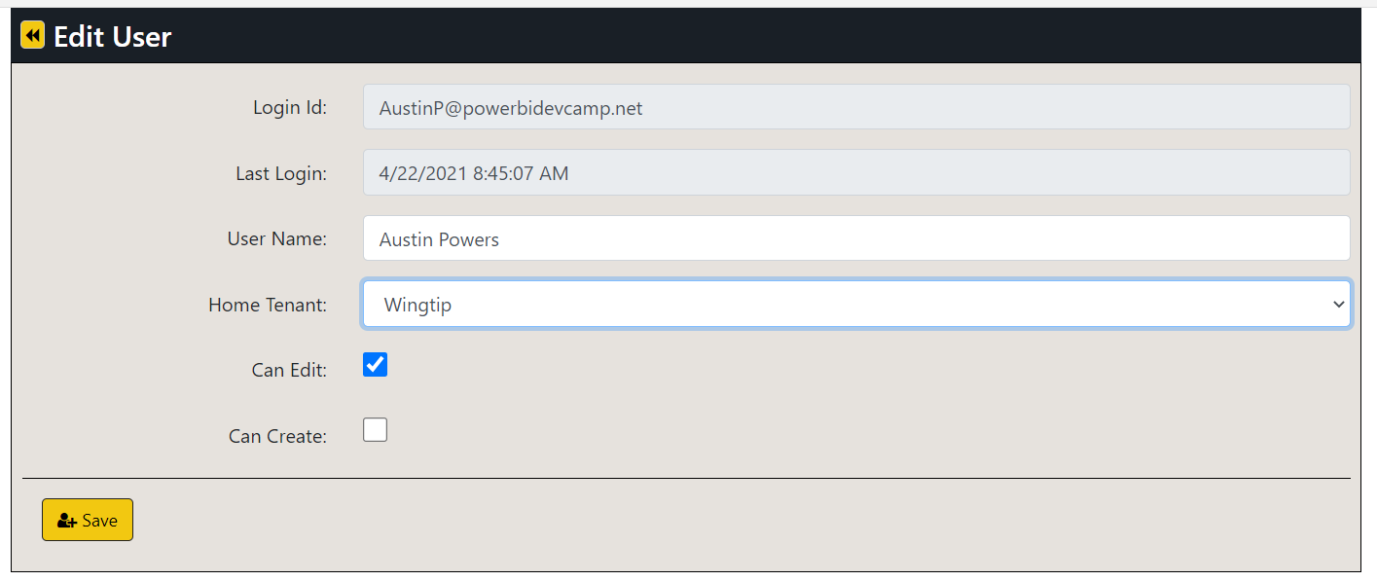
Managing User Permissions

Slide 15
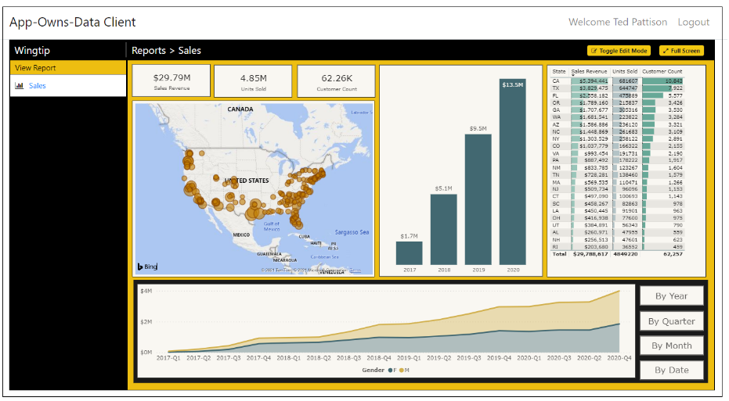
AppOwnsDataClient
AppOwnsDataClient
AppOwnsDataWebAPI
Azure AD Client App

Slide 16
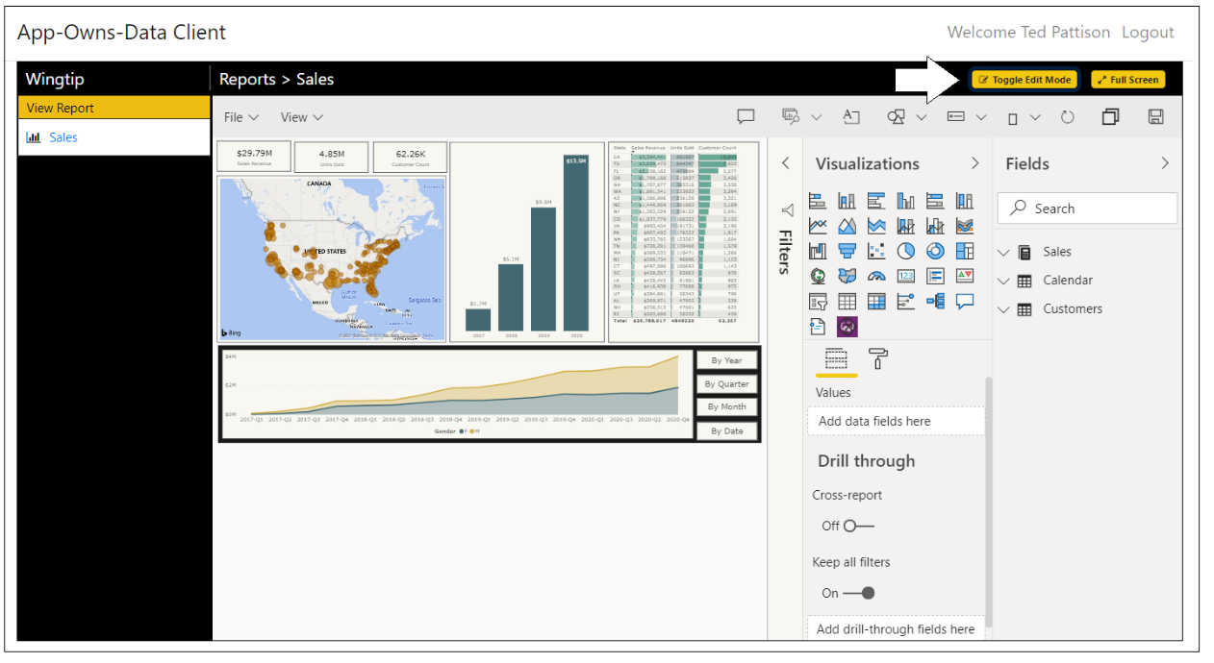
Report Authoring

Slide 17
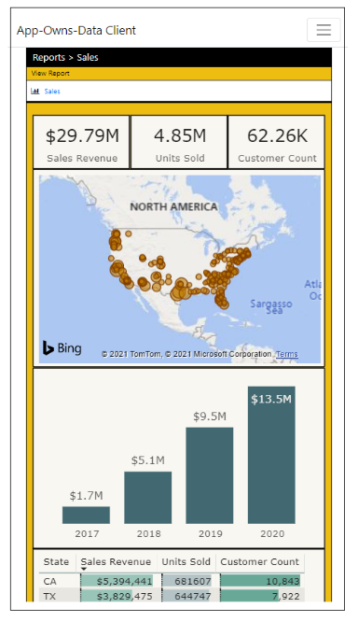
Responsive Design

Slide 18
AppOwnsDataWebApi
AppOwnsDataClient
AppOwnsDataWebAPI
Power BI REST API
Azure AD Client App
Azure AD Service App
AppOwnsDataDB

Slide 19
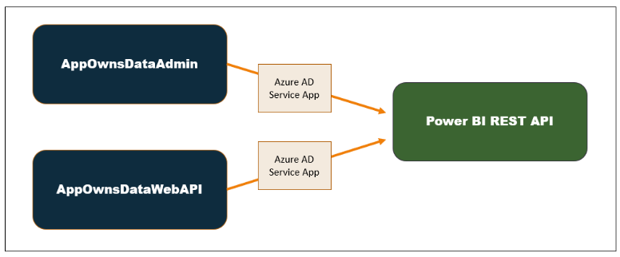
Using a single service principal

Slide 20
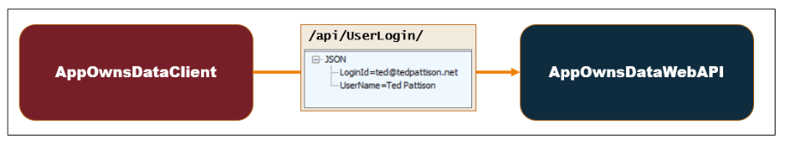
User Login

Slide 21
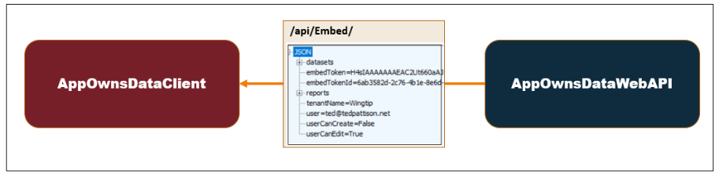
Embedding Data View Model

Slide 22
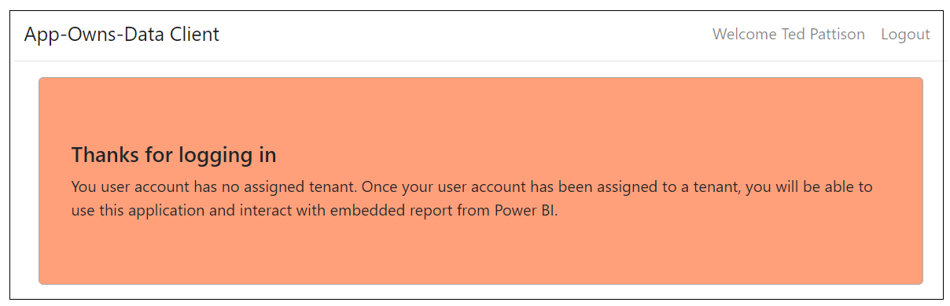
Unassigned Users

Slide 23
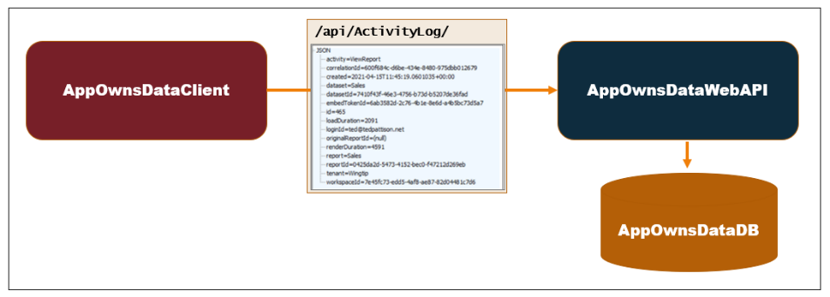
Adding a custom telemetry layer

Slide 24
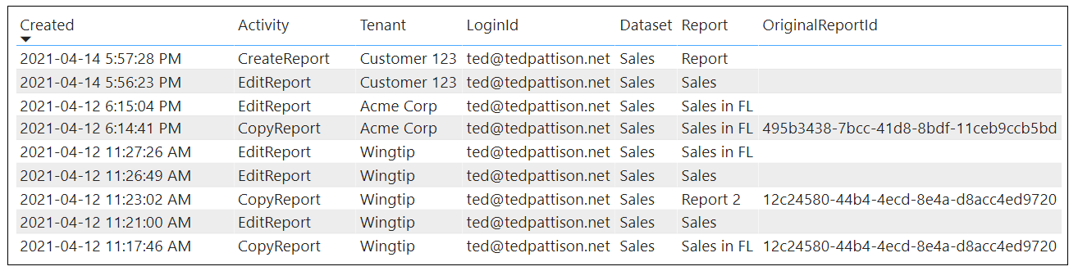
Monitoring User Activity

Slide 25
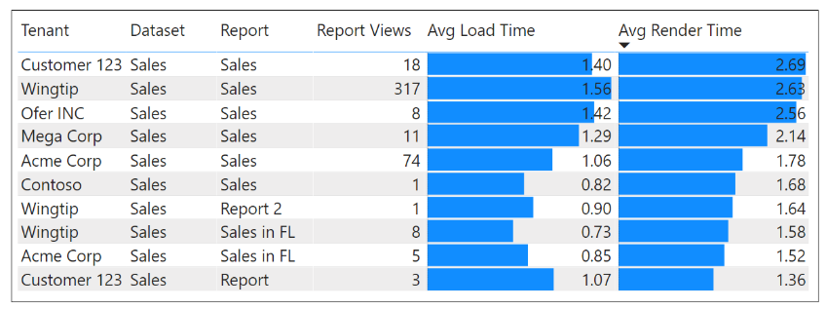
Monitoring Report Performance

Slide 26
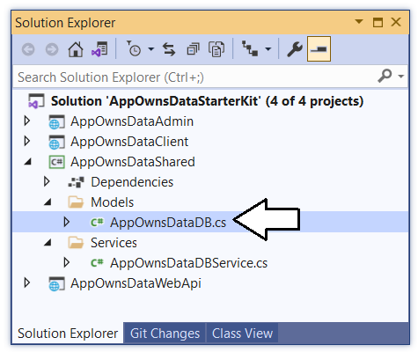
AppOwnsDataShared class library

Slide 27
Agenda
Solution Architecture
Set up your development environment
Open the App-Owns-Data Starter Kit in Visual Studio
Test the AppOwnsDataAdmin application
Test the AppOwnsDataClient application
Use activity logs to monitor user activity and report performance

Slide 28
Setting up your development environment
Create an Azure AD security group named Power BI Apps
Configure Power BI tenant-level settings for service principal access
Create the Azure AD Application named App-Owns-Data Service App
Create the Azure AD Application named App-Owns-Data Client App

Slide 29
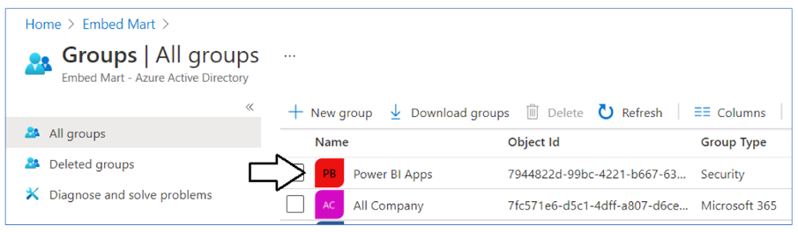
Create the Power BI Apps Group in Azure AD

Slide 30
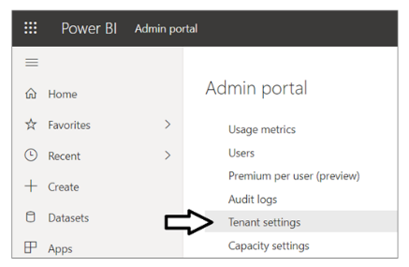
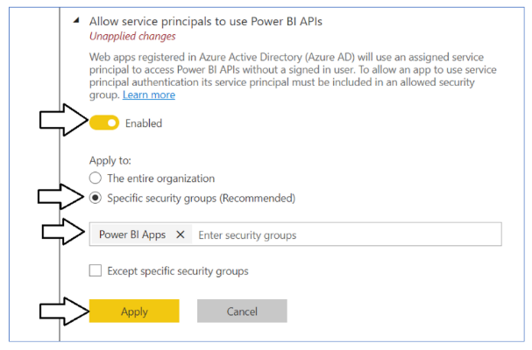
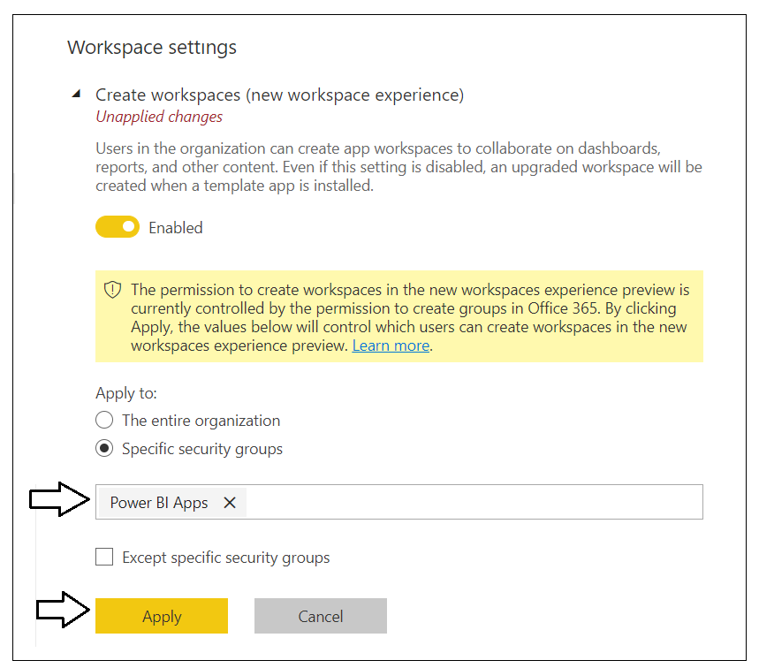
Configure service principal support in Power BI

Slide 31
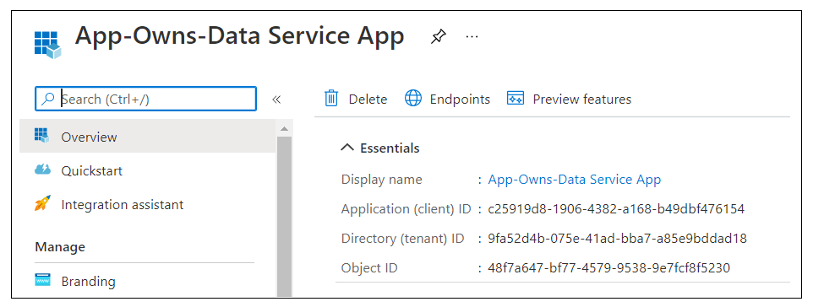
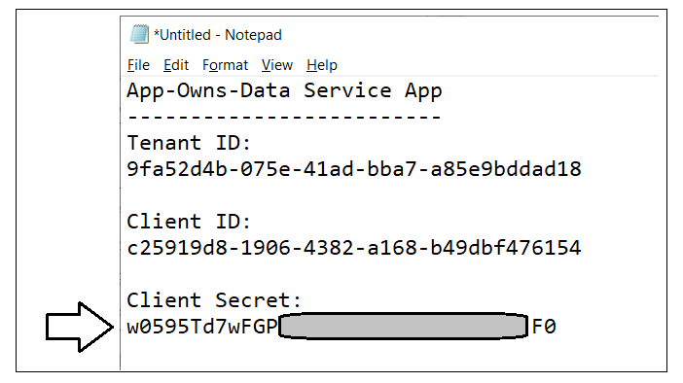
Create the App-Owns-Data Service App

Slide 32
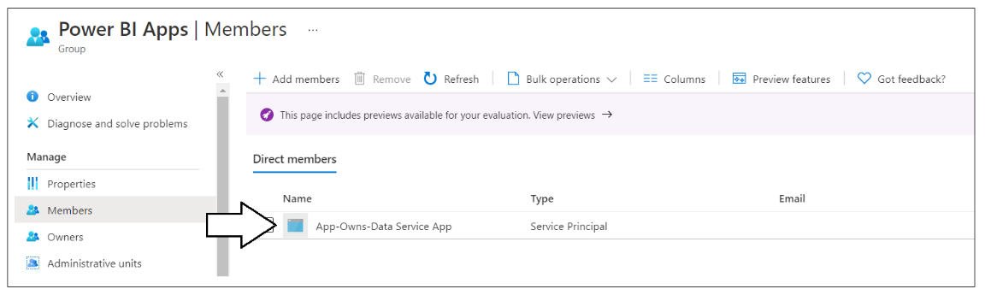
Add the Azure AD App to Power BI Apps Group

Slide 33
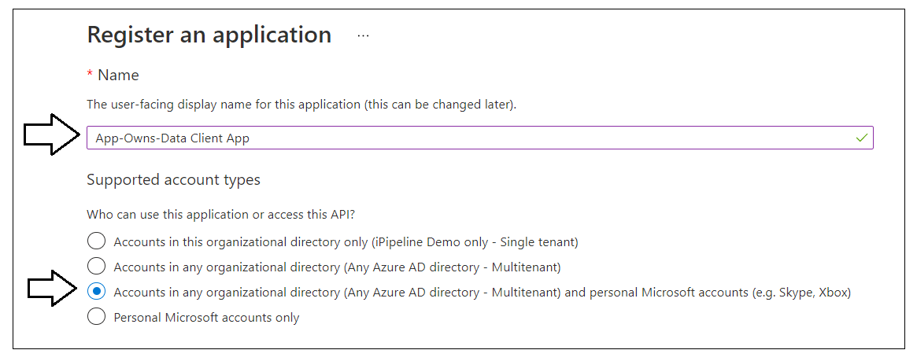
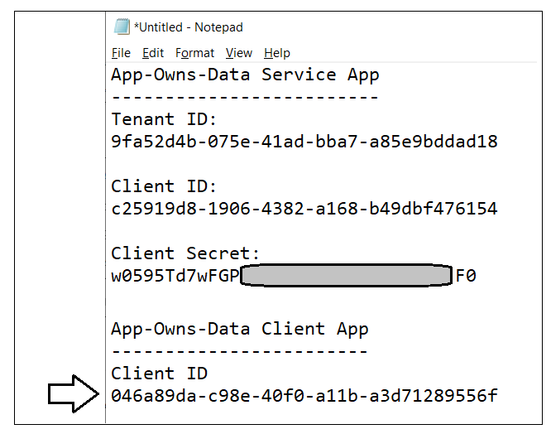
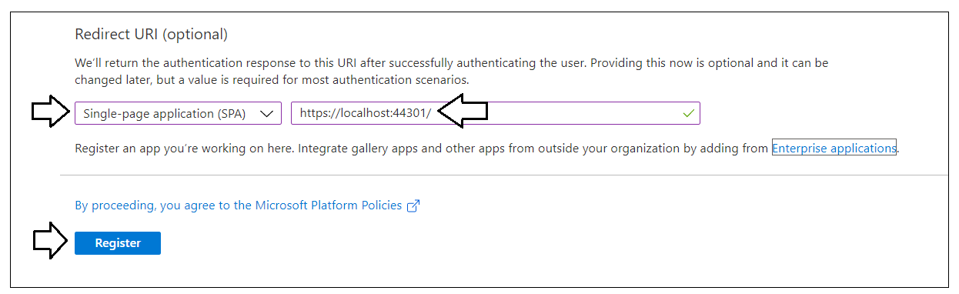
Create the App-Owns-Data Client App

Slide 34
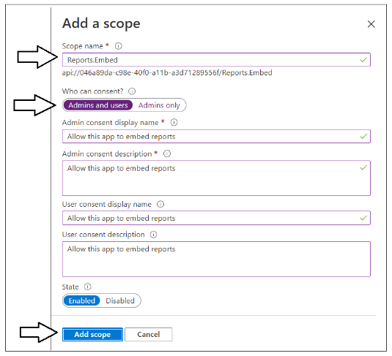
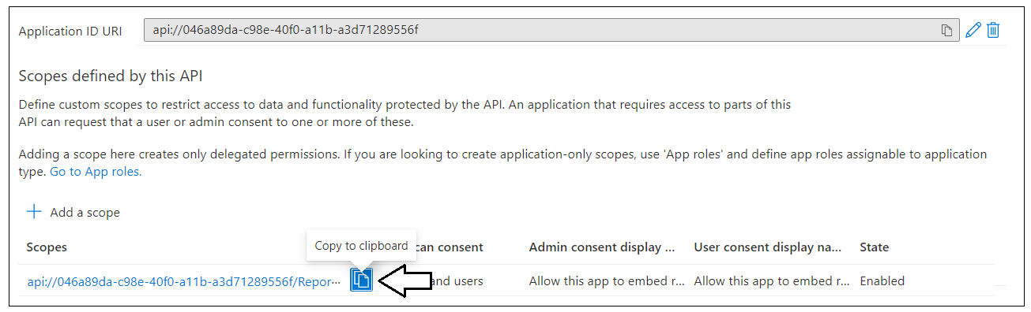
Creating a Custom Scope

Slide 35
Agenda
Solution Architecture
Set up your development environment
Open the App-Owns-Data Starter Kit in Visual Studio
Test the AppOwnsDataAdmin application
Test the AppOwnsDataClient application
Use activity logs to monitor user activity and report performance

Slide 36
Install the Required Developer Software
.NET 5 SDK
https://dotnet.microsoft.com/download/dotnet/5.0
Node.js
https://nodejs.org/en/download/
Visual Studio 2019
https://visualstudio.microsoft.com/downloads/
Visual Studio Code
https://code.visualstudio.com/Download

Slide 37
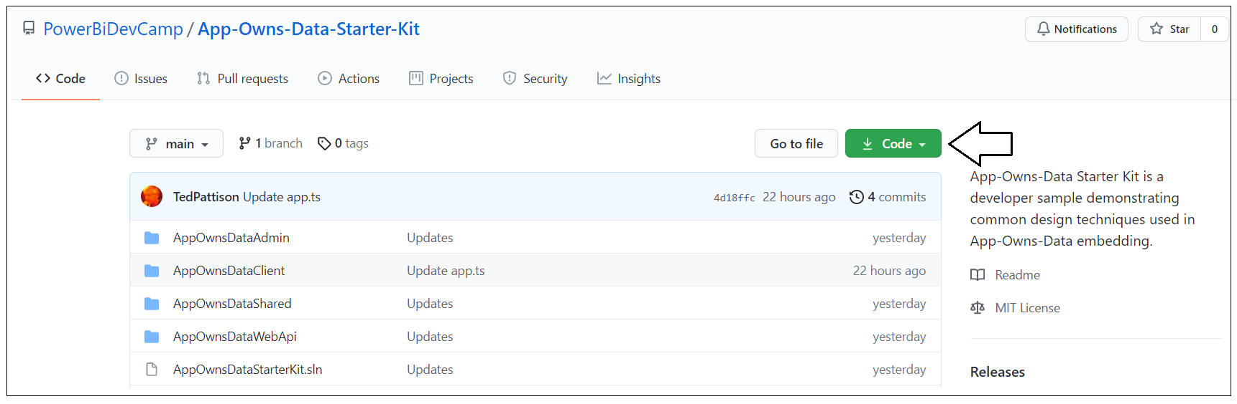
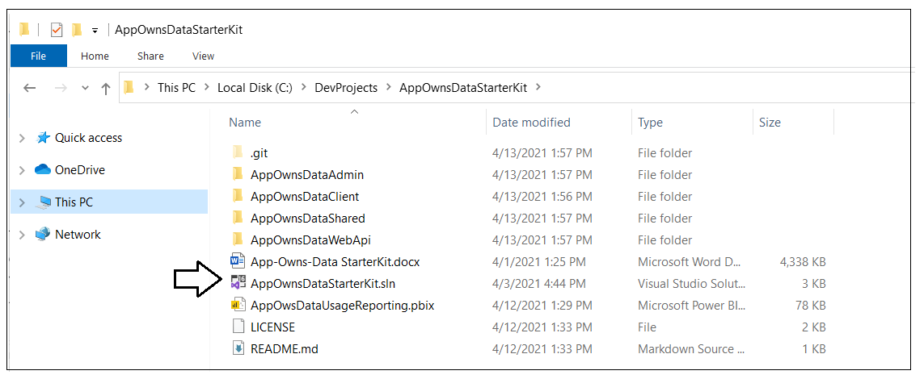
Download the source code

Slide 38
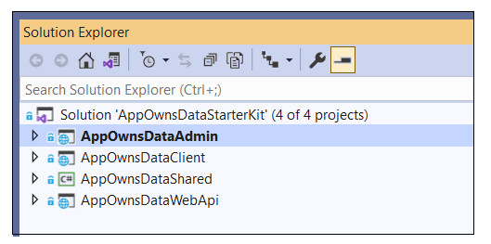
Open AppOwnsDataStarterKit.sln in Visual Studio
AppOwnsDataAdmin
ASP.NET MVC Web Application built using .NET 5
AppOwnsClient
Single page application built using HTML, CSS and Typescript
AppOwnsDataShared
Class library project used to generate AppOwnsDataDB
AppOwnsDataWebApi
ASP.NET Web API which provides embedding data to AppOwnsDataClient

Slide 39
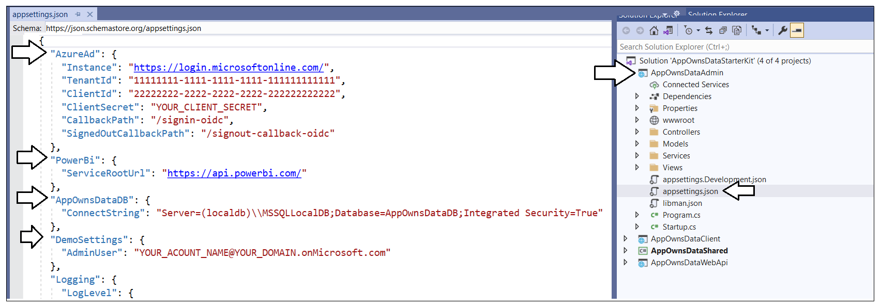
Update appsettings.json in AppOwnsDataAdmin

Slide 40
AppOwnsDataShared class library

Slide 41
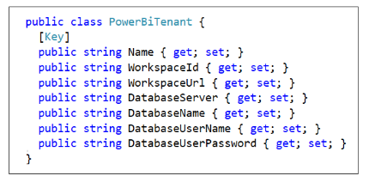
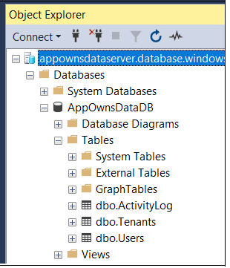
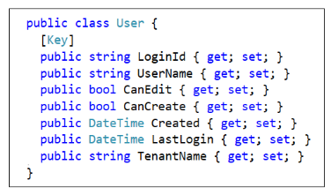
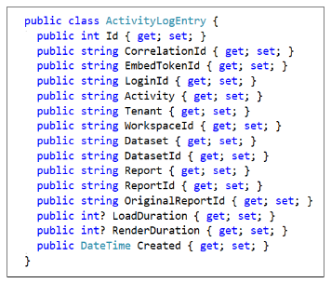
AppOwnsDataDB
Entity Framework Core

Slide 42
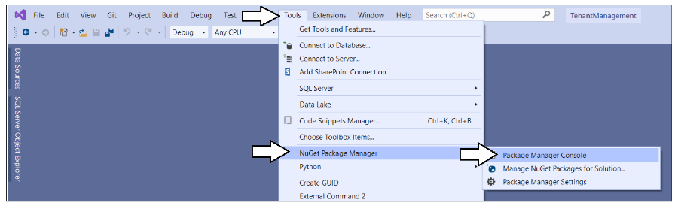
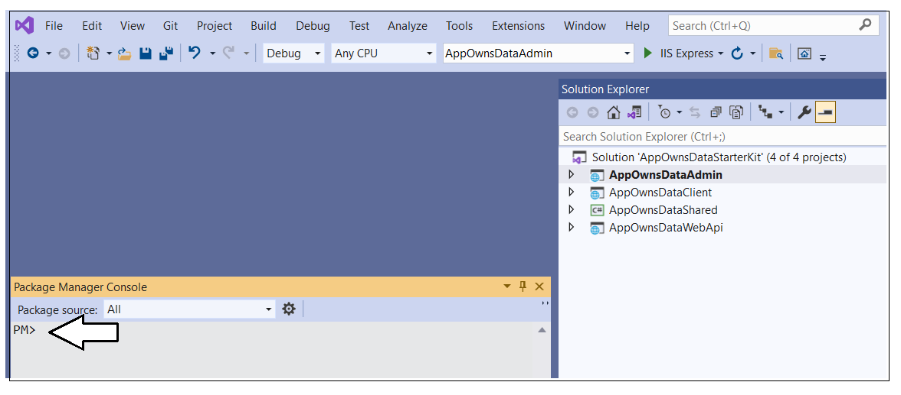
Package Manager Console

Slide 43
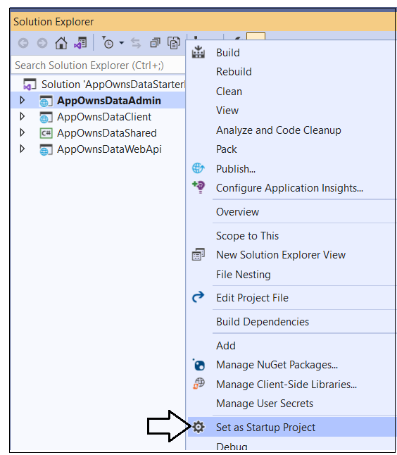
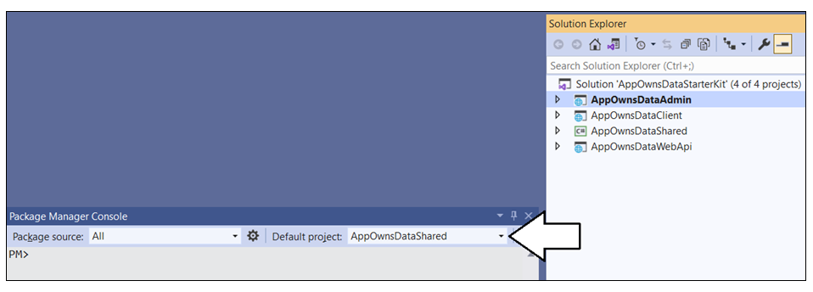
Getting Ready to create the database

Slide 44
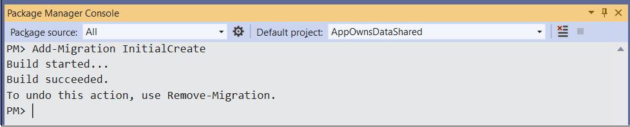
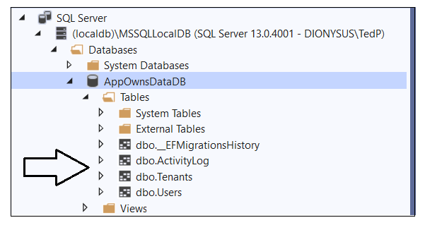
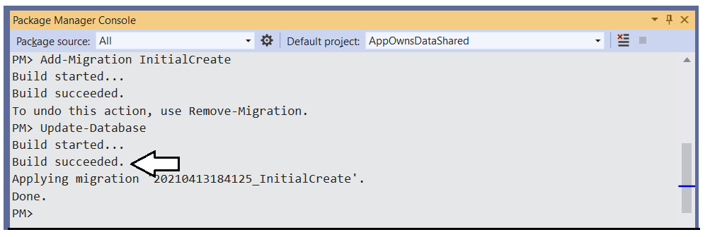
Create the AppOwnsDataDB database

Slide 45
Agenda
Solution Architecture
Set up your development environment
Open the App-Owns-Data Starter Kit in Visual Studio
Test the AppOwnsDataAdmin application
Test the AppOwnsDataClient application
Use activity logs to monitor user activity and report performance

Slide 46
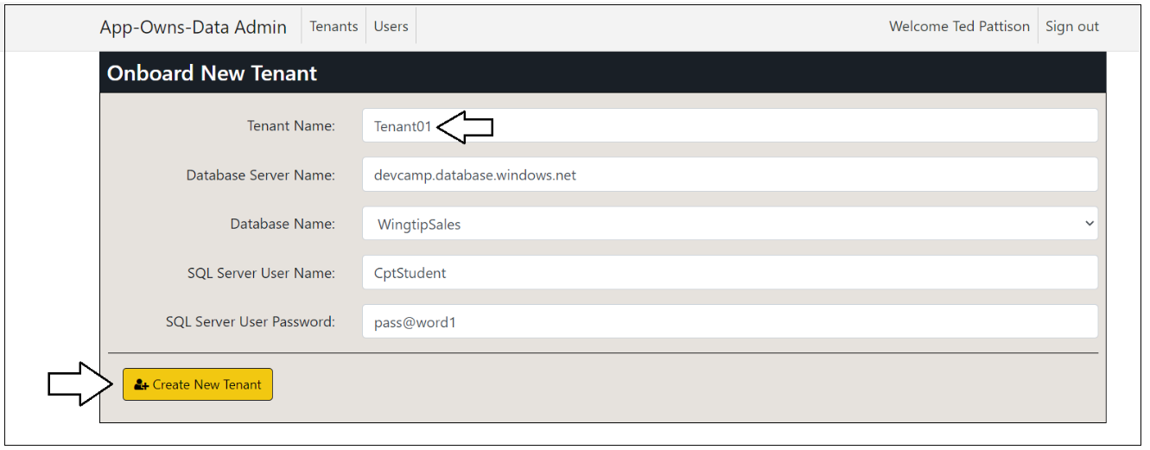

Create New Customer Tenants

Slide 47

Tenant Details

Slide 48



Understanding SalesReportTemplate.pbix

Slide 49



Report Design

Slide 50


Embedding Reports in AppOwnsDataAdmin

Slide 51


What’s been created in Power BI?

Slide 52
Agenda
Solution Architecture
Set up your development environment
Open the App-Owns-Data Starter Kit in Visual Studio
Test the AppOwnsDataAdmin application
Test the AppOwnsDataClient application
Use activity logs to monitor user activity and report performance

Slide 53

Update appsettings.json in AppOwnsDataWebApi

Slide 54

Configure and build AppOwnsDataClient

Slide 55

Node.js integration

Slide 56



Building AppOwnsDataClient

Slide 57


Test AppOwnsDataClient in Visual Studio

Slide 58

Side by Side

Slide 59



Assign User Permissions

Slide 60



User Experience

Slide 61



Edit reports using AppOwnsDataClient

Slide 62



Create new content using AppOwnsDataClient

Slide 63
Agenda
Solution Architecture
Set up your development environment
Open the App-Owns-Data Starter Kit in Visual Studio
Test the AppOwnsDataAdmin application
Test the AppOwnsDataClient application
Use activity logs to monitor user activity and report performance

Slide 64

Monitor user activity with data in the ActivityLog table

Slide 65

AppOwsDataUsageReporting.pbix

Slide 66

Capturing Report Performance Data

Slide 67
Monitor Report Performance

Slide 68
Next Steps
Use a different authentication provider
Create a more granular permissions scheme
Add integration with row-level security (RLS)
Redesign AppOwnsDataClient using React.js or Angular
Learn scaling techniques to support more than 1000 tenants

Slide 69
Summary
Solution Architecture
Set up your development environment
Open the App-Owns-Data Starter Kit in Visual Studio
Test the AppOwnsDataAdmin application
Test the AppOwnsDataClient application
Use activity logs to monitor user activity and report performance

Slide 70
Questions

